Slide 1
Rabi Season Scenario for Canal Reliability in Upper Indus Basin

Slide 2
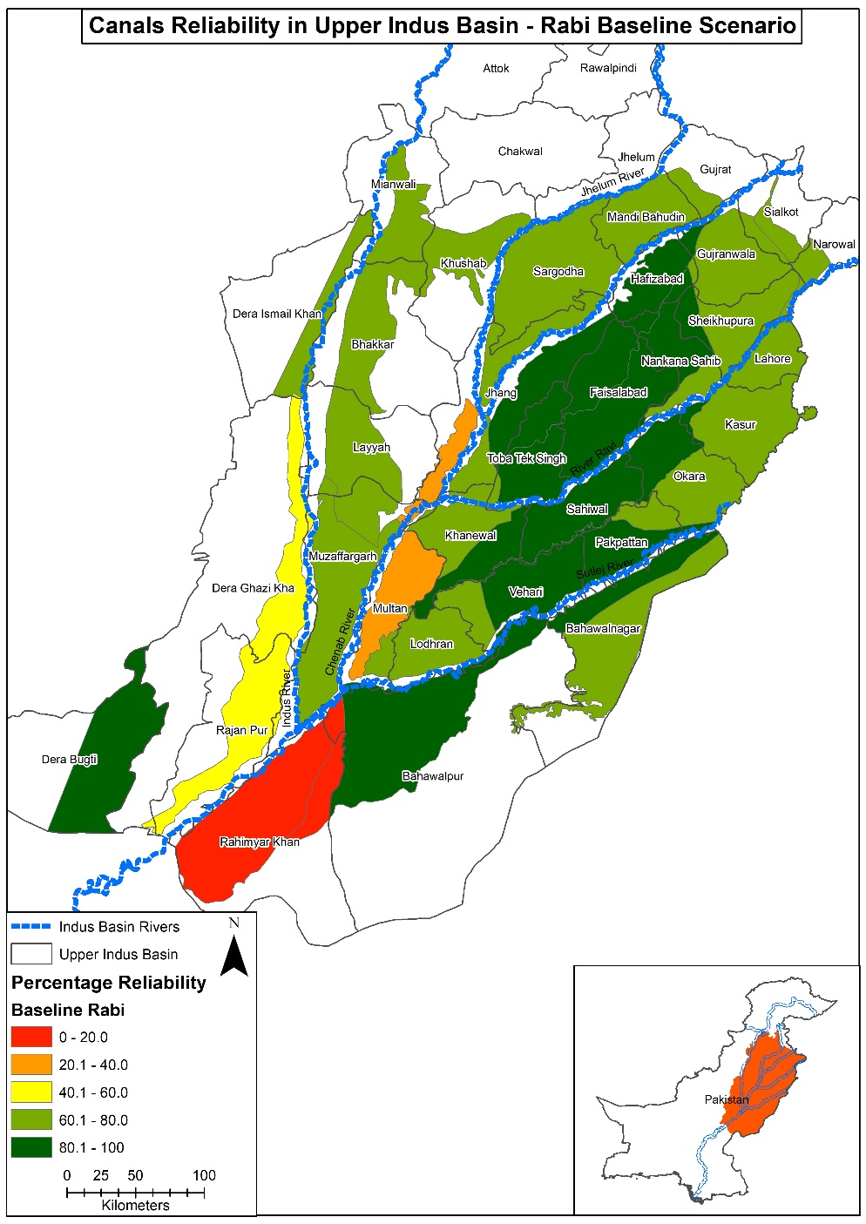
Rabi Baseline Scenario

Slide 3
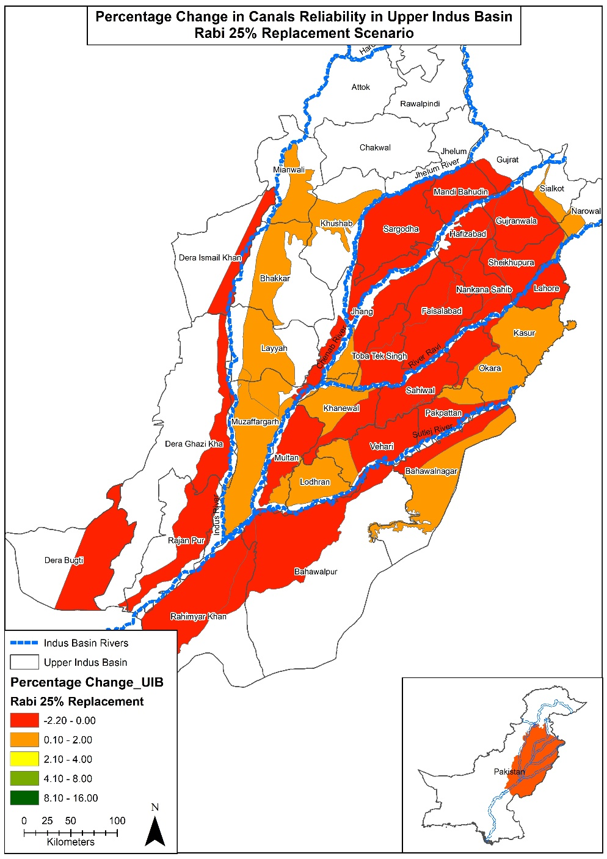
25% Sugarcane Replacement

Slide 4
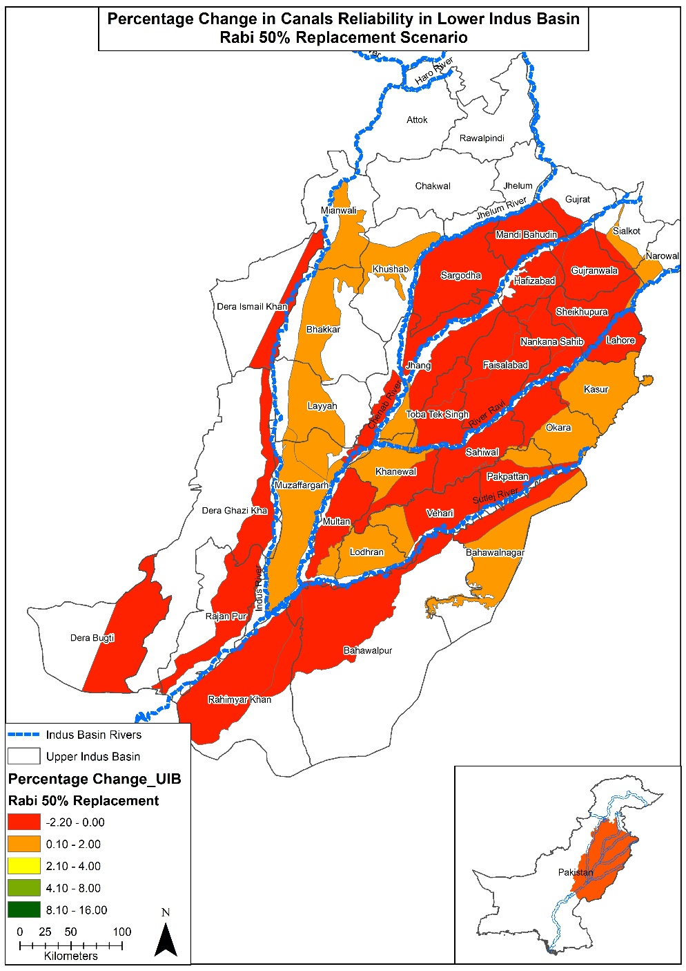
50% Sugarcane Replacement

Slide 5

75% Sugarcane Replacement

Slide 6
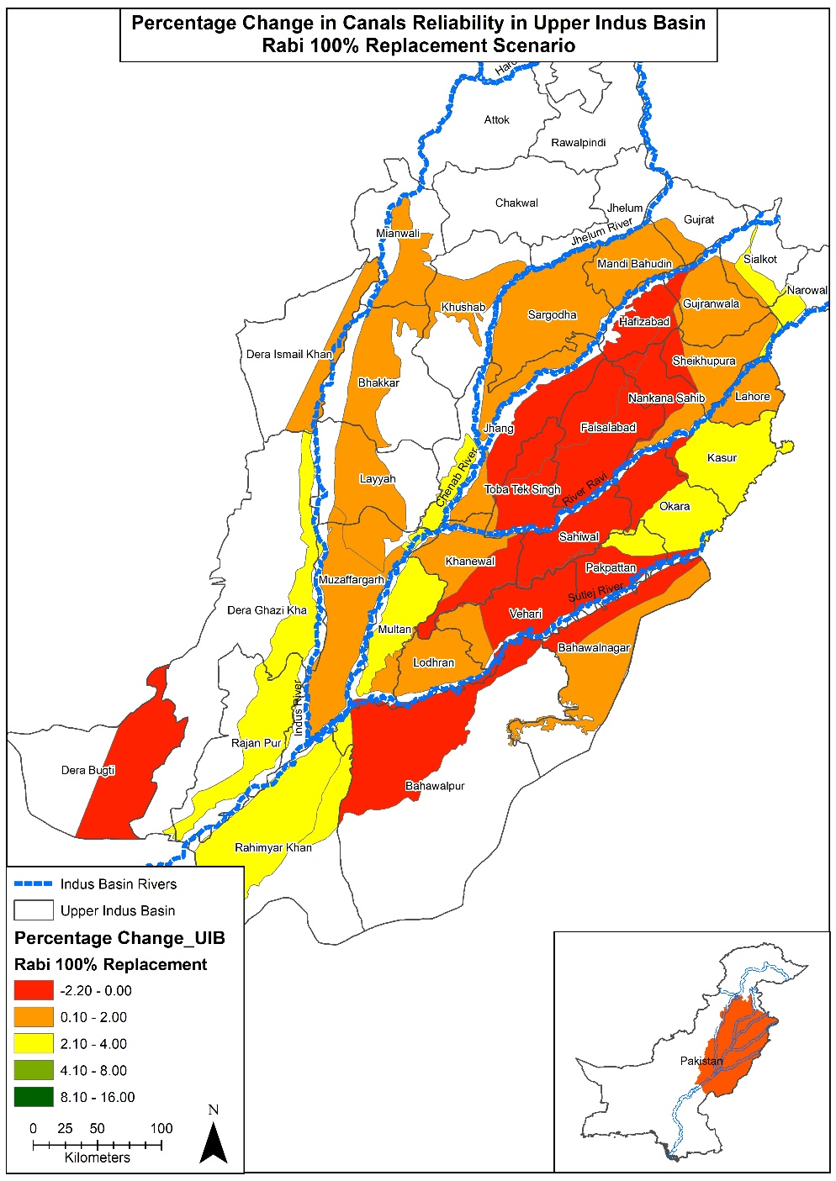
100% Sugarcane Replacement

Slide 7
Rabi Season Scenario for Canal Reliability in Lower Indus Basin

Slide 8
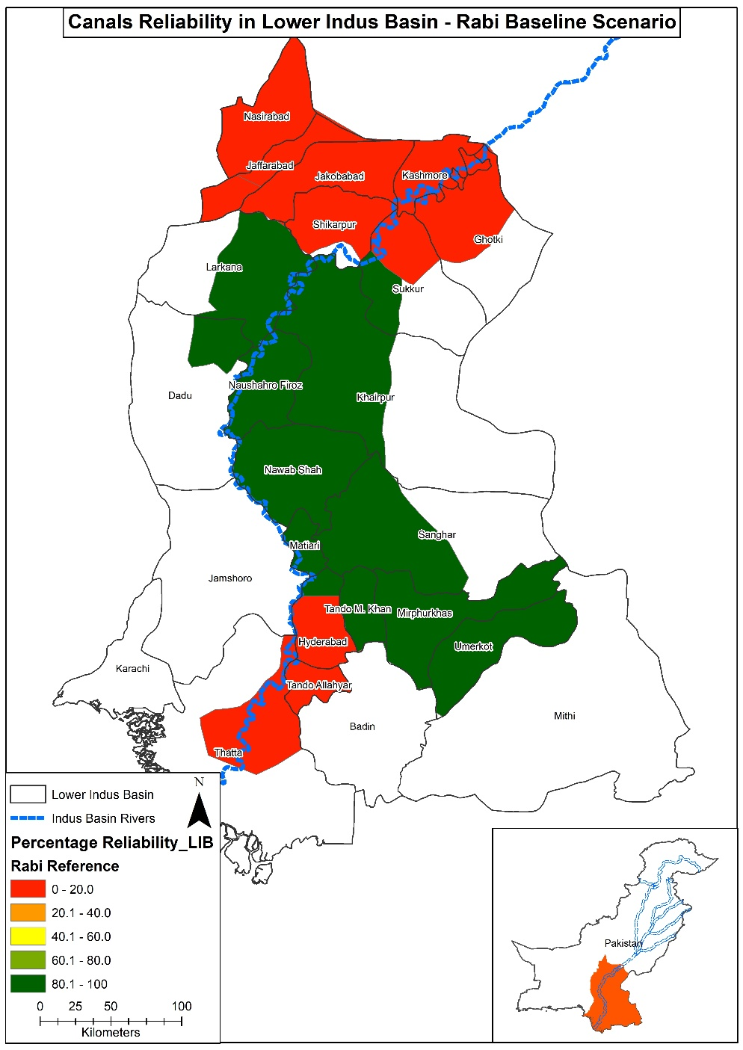
Rabi Baseline Scenario

Slide 9
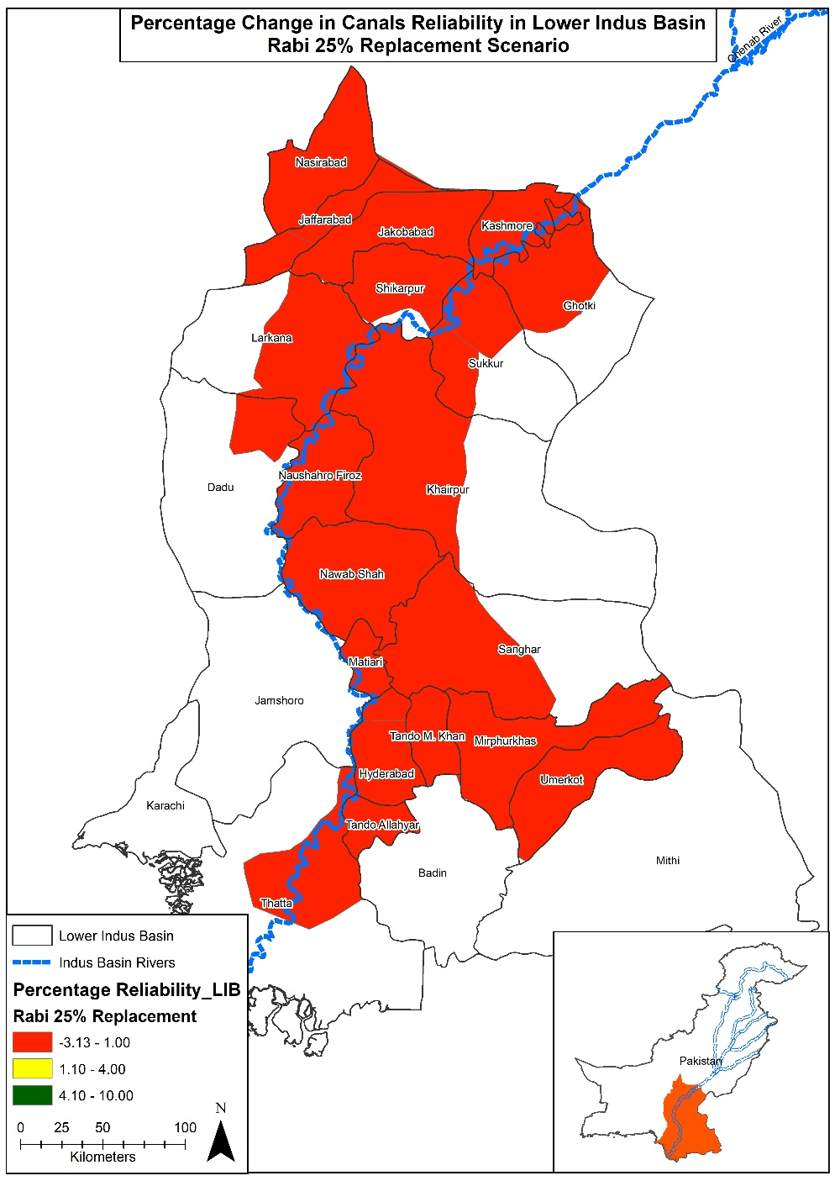
25% Replacement Scenario

Slide 10
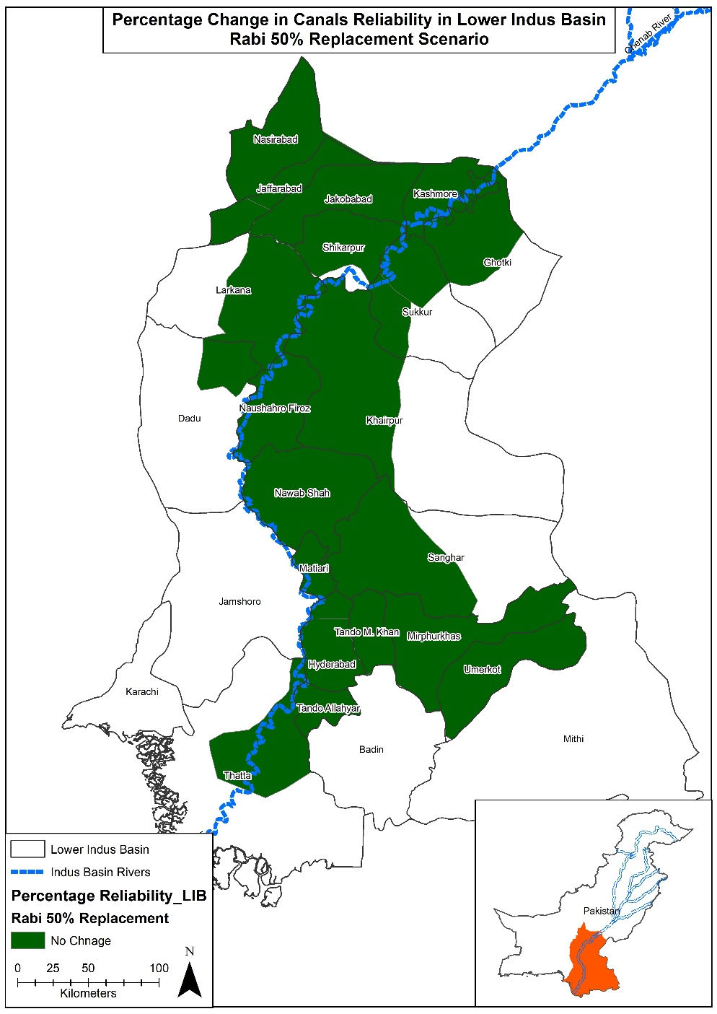
50% Replacement Scenario

Slide 11
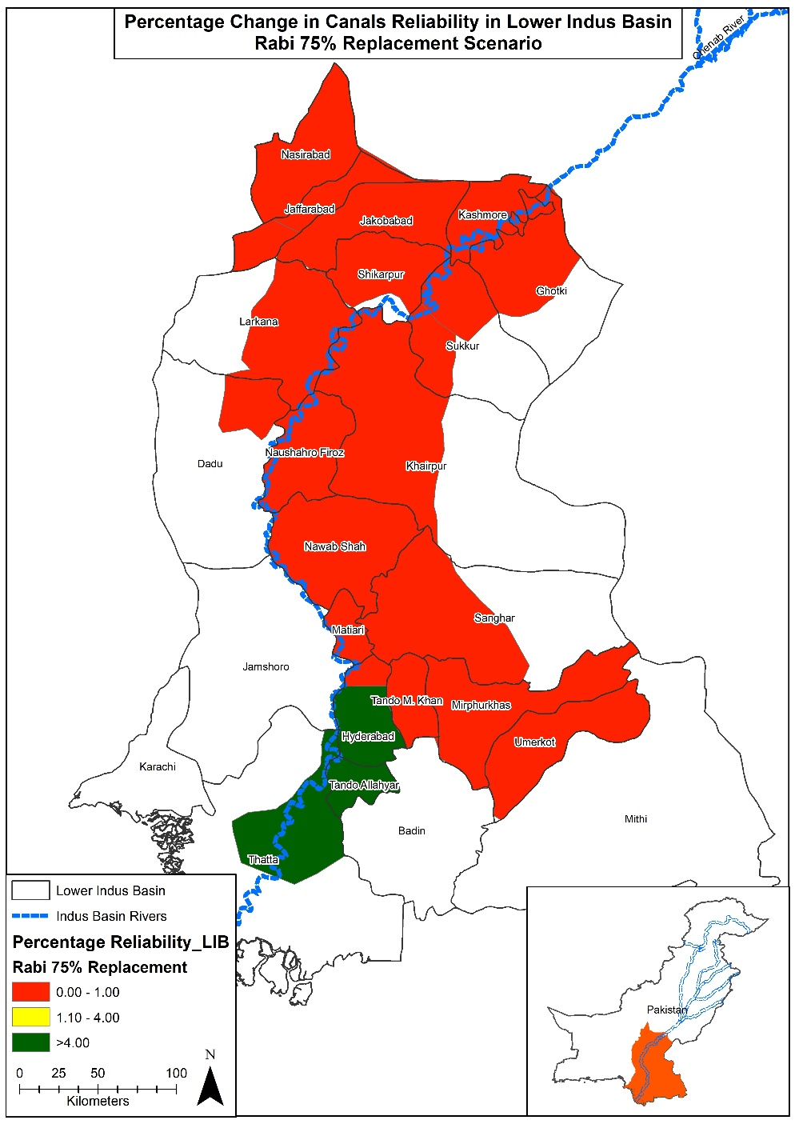
75% Replacement Scenario

Slide 12
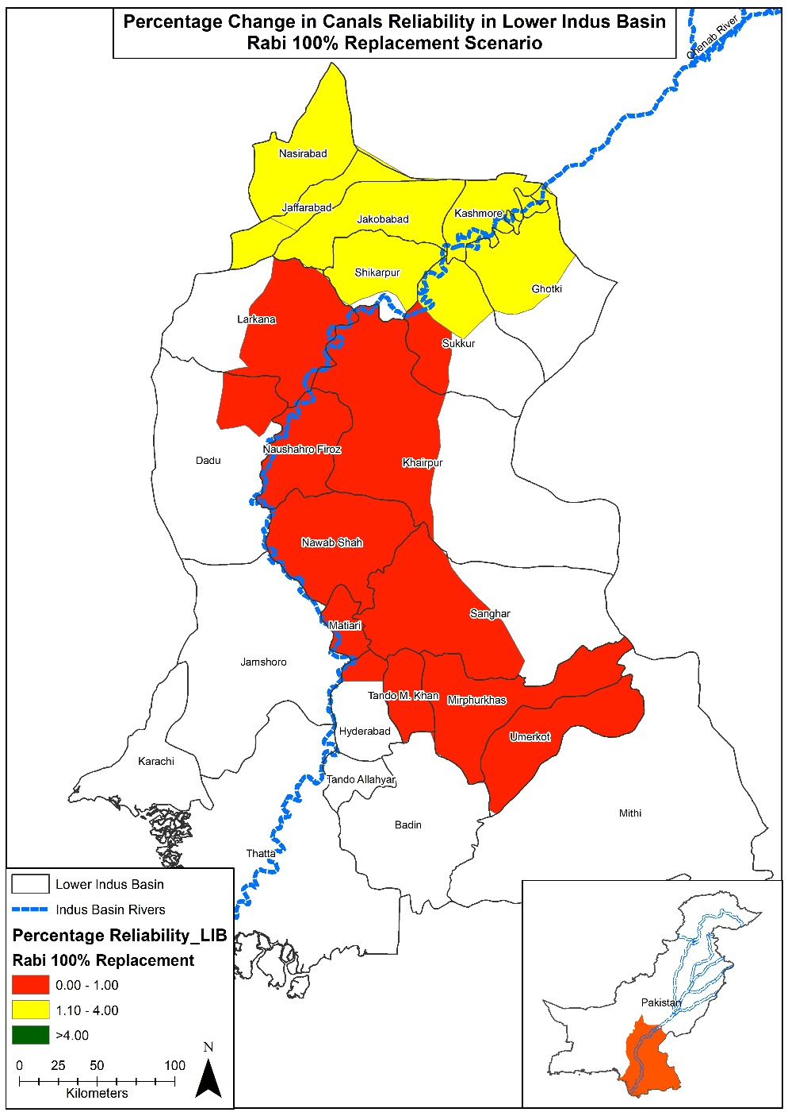
100% Replacement Scenario

